Slide 1



CAR Price Prediction
Guided By:
Shubham Yadav
Presented By:
Gokula Krishnan R

Slide 2
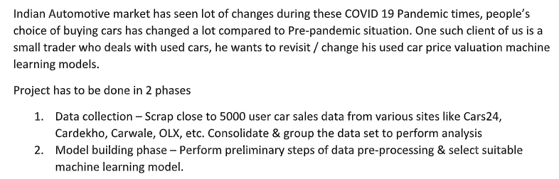
ABSTRACT

Slide 3
EXPERIMENTAL SET UP
Hardware requirements:-
1. Processor — core i5 and above
2. RAM — 8 GB or above
3. SSD— 250 GB or above
Software requirements:-
1. ANACONDA

Slide 4
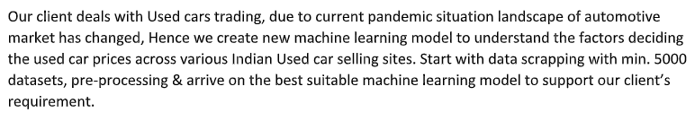
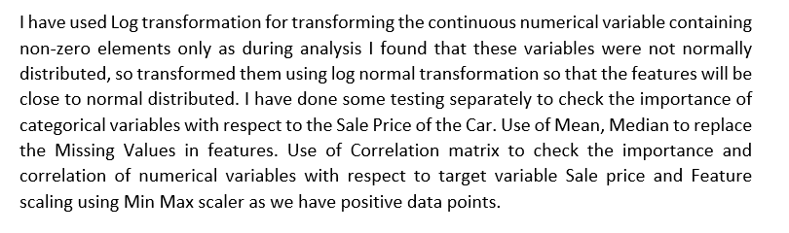
INTRODUCTION

Slide 5
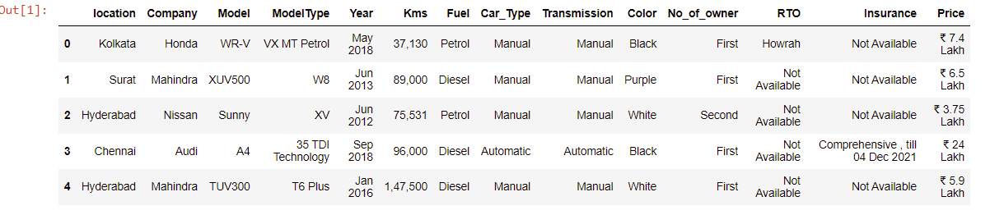
DATA PREPRATION
With the help of Pandas Library, We will upload our data to Jupyter Notebook.
Once our data is uploaded with the help of predefined method (i.e. read_csv) we can read data for further processing.
We have two type of variables in the data:-
Dependent Variable
Independent Variable

Slide 6
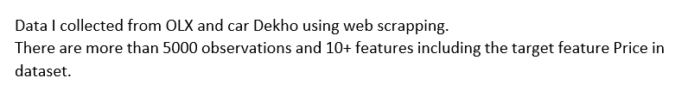
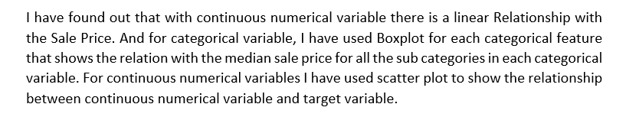
Car price is a dependent variable whereas all of the other elements are independent variables.

Slide 7

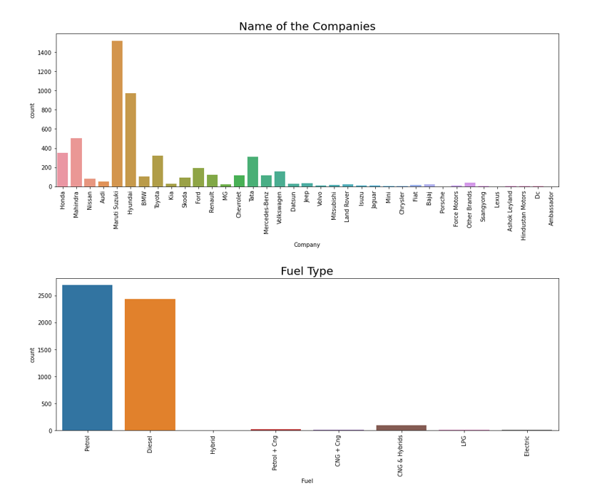

Slide 8
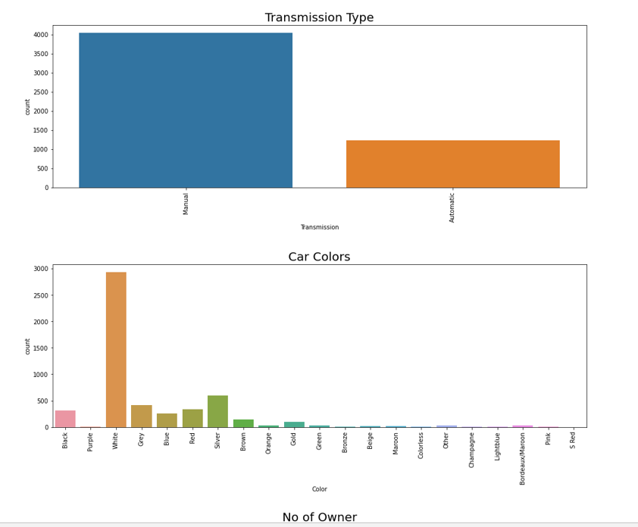

Slide 9
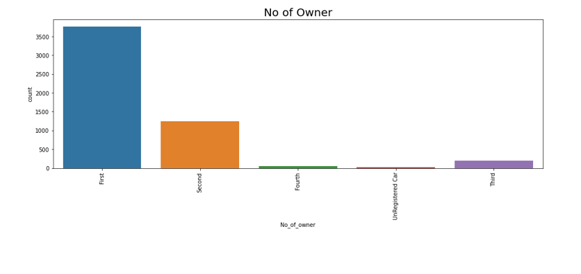
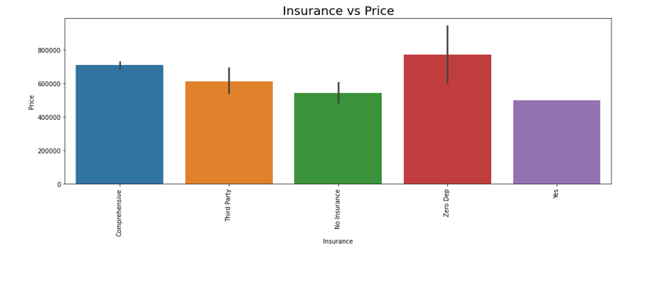

Slide 10
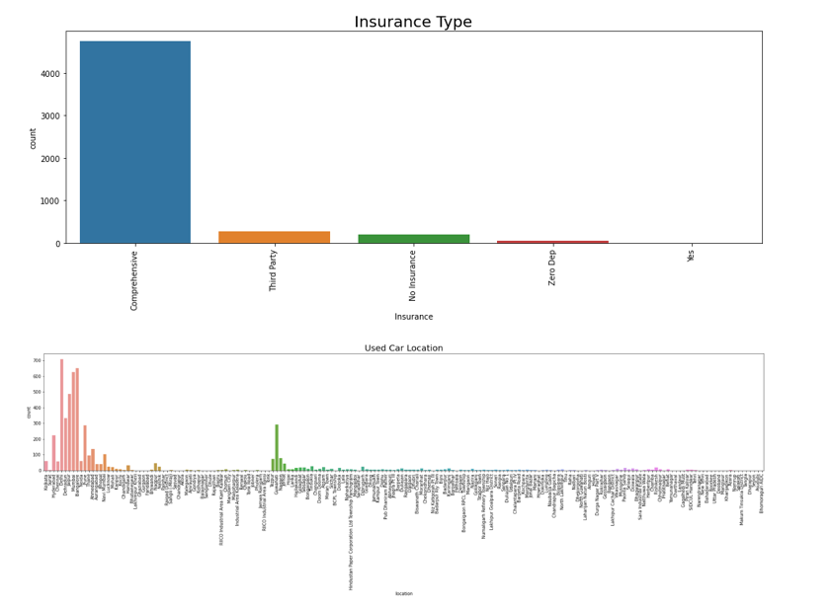

Slide 11
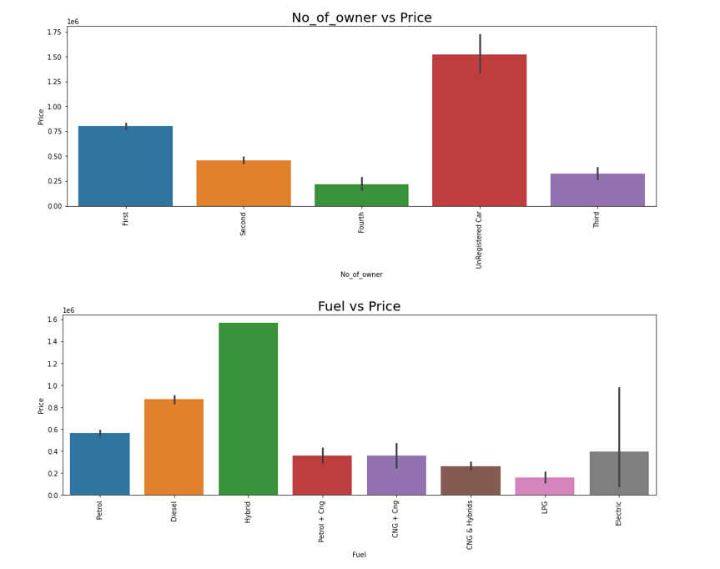

Slide 12
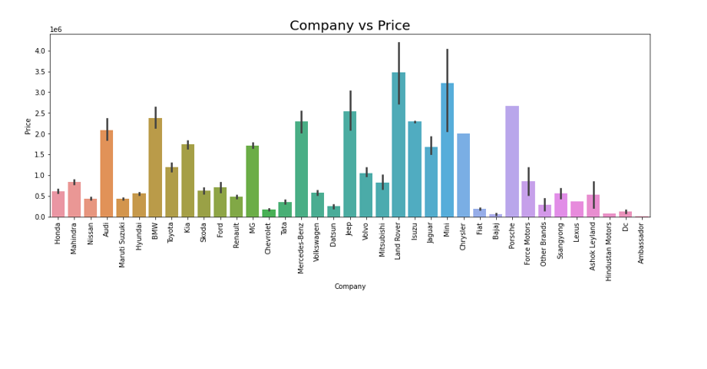
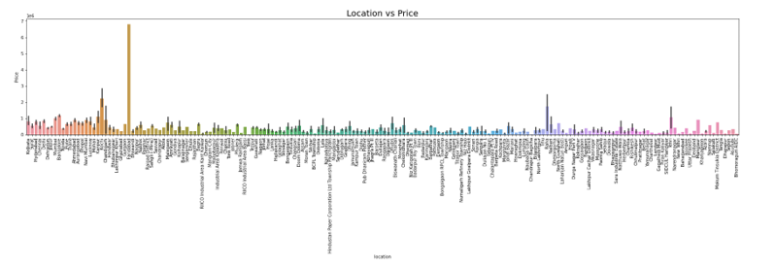

Slide 13
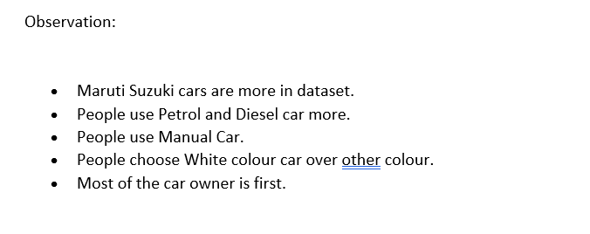
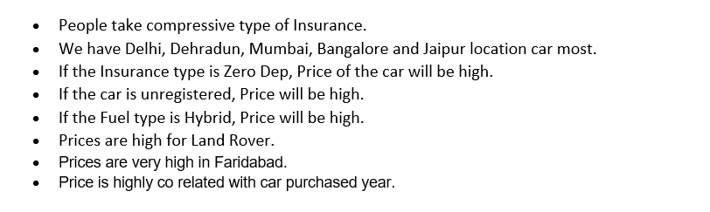

Slide 14
DATA PREPROCESSING
The Complete data is divided in the ration of 70:30 for train and test respectively.
There is lots of null values present in the dataset and there are some outliers present in the dataset which has been removed with the help of medium of the columns and Z score.
Once our data is ready categorical variables are converted into the numeric form, which we can apply further on algorithms.
I have dropped the some column since there is no correlation between output variable and with those columns.

Slide 15
EVALUTION PROCESS
R2 Score:
Adjusted R2 Score deals with additional independent variables.
This R squared value of the r-square if our choice of independent variable wasn’t good (i.e. independent variable had no effect on dependent variable)
Also the bias of R Square to not decrease is handled pretty well in this adjusted R Squared method.
Cross Validations:
K Fold cross validations , K = 5

Slide 16
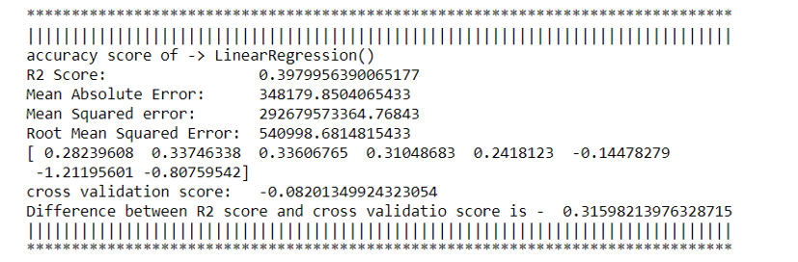
Linear Regression

Slide 17
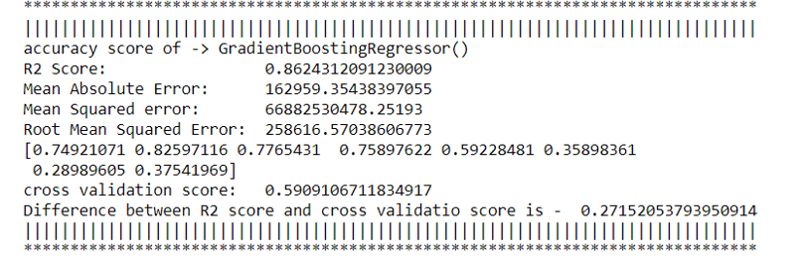
Gradient Boosting Regressor

Slide 18
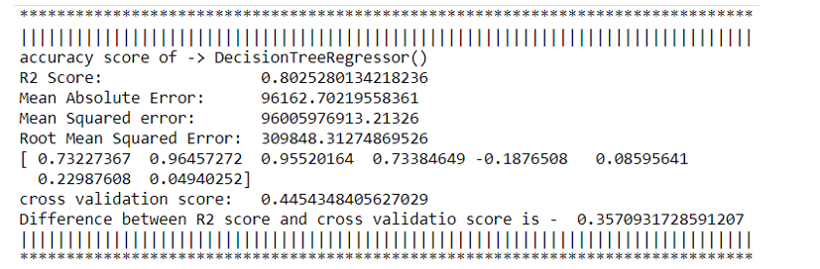
Decision Tree Regressor

Slide 19
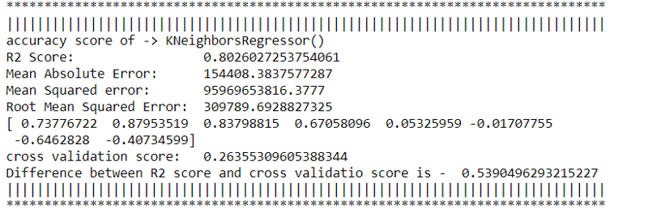
K Neighbors Regressor

Slide 20
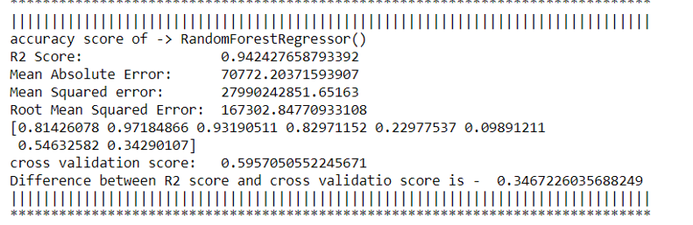
Random Forest Regressor

Slide 21
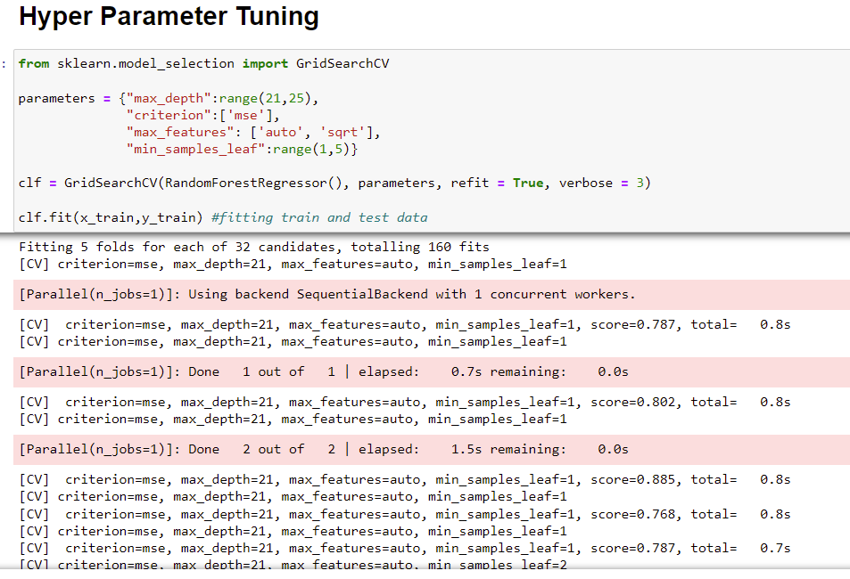
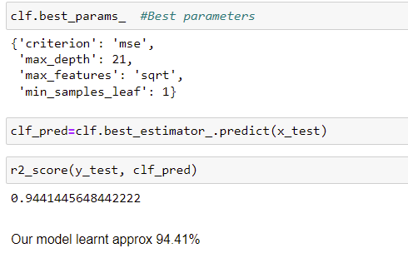
RESULT
From the details on the above solutions it is clearly understandable that we are getting best result with the help of Random Forest Regressor so we save this model with the help of joblib Library.

Slide 22
CONCLUSION
From this dataset I get to know that each feature plays a very import role to understand the data. Data format plays a very important role in the visualization and Appling the models and algorithm
The power of visualization is helpful for the understanding of data into the graphical representation its help me to understand that what data is trying to say, Data cleaning is one of the most important steps to remove missing value or null value fill it by mean median or by mode or by 0.
Various algorithms I used in this dataset and to get out best result and save that model. The best algorithm is Random Forest Regressor.

Slide 23
FUTURE WORK
Limitations of this project is we have less number of features. If we get interior column, where we will get feature like, A/C, air bag etc. More the number of features, more accuracy we’ll get.
In future, if someone do the proper and detail study of this dataset’s each column than the accuracy will be so high.

Slide 24

Thank you

